Slide 1


DEPARTMENT OF COMPUTER SCIENCE & ENGINEERING
SCHOOL OF COMPUTING
10214CS601 MINOR PROJECT -1
SUMMER SEMESTER(2023-2024)
SEMESTER END PROJECT VIVA VOCE EXAMINATIONS
“EARLY PREDICTION OF COVID-19 USING MACHINE LEARNING TECHNIQUES”
SUPERVISED BY
PRESENTED BY
Dr.K.ANTONY KUMAR,ME,PhD
1.GURRAMPATI USHASWI (VTU20205)(21UECM0092)
2.PAILA LOKESH KUMAR (VTU20215)(21UECM0175)
3.MADEM HARSHITHA (VTU19287)(21UECM0292)

Slide 2
OVERVIEW
ABSTRACT
OBJECTIVE
INTRODUCTION
LITERATURE REVIEW (SOFT COPY OF PAPERS TO BE LINKED AS HYPERLINK)
DESIGN AND METHODOLOGIES
IMPLEMENTATION
TESTING
INPUT AND OUTPUT
INCLUDE DEMO VIDEO (You Tube URL of complete demonstration of project by All members as Voice over)
CONCLUSION
FUTURE ENHANCEMENTS
SOCIETAL IMPACT OF PROJECT
WEB REFERENCES LINK (TILL REVIEW DATE ALL LINKS TO BE INCLUDED DAY WISE)
PLAGIARISM REPORT OF PROJECT REPORT AND PPT
POSTER PRESENTATION
JOURNAL/CONFERENCE PUBLICATION PROOF
REFERENCES

Slide 3
ABSTRACT
Address the global impact of the COVID-19 pandemic and the urgency for effective prediction strategies.
Emphasize the aim of utilizing machine learning algorithms for COVID-19 prediction to enhance preparedness and proactive measures.
Outline the methodology involving the application of machine learning algorithms, highlighting data sources and model selection.
The dataset used for analysis is collected from GitHub and is regularly updated.
Results obtained from experiments are being analyzed to understand the patterns and trends in COVID-19 data.
Machine learning methods are employed for predictive modeling to estimate the future number of COVID-19 cases and deaths.
The predictive methods focus on estimating the numbers over the next two weeks, providing a short-term outlook.
The dataset is actively maintained and updated, ensuring that the predictions remain relevant and reflective of the current scenario.

Slide 4
OBJECTIVES
Aim of the Project:
The primary goal of the experiment is to predict the virus for the next ten days. The overall number of instances, as well as active and fatal cases, are detected by our project. Identifying the most suitable machine learning technique for prediction, to perform on clinical reports of patients.
Scope of the Project:
This research focuses on development of a machine learning model for predicting COVID-19 in patients.
We also work to identify the features from the clinical information of patients that would influence the predictive result of COVID-19.
This study does not focus on outer factors such as weather or any environmental factors that might influence results.
Emphasize precision and specificity in the predictive model, aiming for a detailed understanding of patient-specific factors contributing to COVID-19 prediction

Slide 5
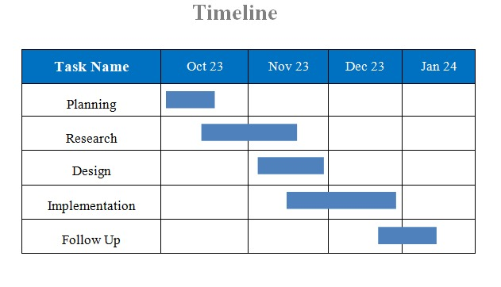
TIMELINE OF THE PROJECT
GANNT CHART
The above Gantt chart tells about that in the planning phase, key milestones such as research, design, and implementation are plotted, providing a clear roadmap for task completion over specific months. From October to November, intensive research lays the groundwork, followed by design in November. Implementation spans November to December, with a comprehensive follow-up from December to January, ensuring a systematic and successful project execution. The Gantt chart streamlines follow-up, ensuring smooth progress tracking and overall project success.

Slide 6
INTRODUCTION
COVID-19, a new coronavirus, caused an epidemic in Wuhan, China, in December 2019. It quickly expanded to over 200 nations throughout the world following its inception.
The number of verified COVID-19 infected patients is expanding at an exponential rate throughout the world. COVID-19 has infected over 17 million individuals too far, with over 0.7 million people are dying as a result.
This pandemic continues to challenge medical systems worldwide in many aspects, including sharp increases in demands for hospital beds and critical shortages in medical equipment, while many healthcare workers have themselves been infected
Recognizing the urgency, there's a need for a technological tool to estimate infections and anticipate worst-case scenarios.
There is a need for more efficient use of the scarce resources without compromising the quality.
The tests that measure the Coronavirus to determine the presence of illness, are to be examined more since the range of symptoms of positive cases has been rising.
The goal of this study is to create a model that predicts the number of confirmed cases caused by COVID-19 in the selected region of India based on data from several countries.

Slide 7
INTRODUCTION
Algorithm Selection: Utilize Support Vector Machine (SVM) for forecasting due to its ability to handle non-linear relationships through the kernel trick, converting low-dimensional input space to high-dimensional space.
Data Splitting: Divide the dataset into a 95:05 ratio for training and testing purposes, respectively.
SVM Classifier Explanation: Employ SVM with a linear classifier that separates data using hyper-planes, ensuring maximum distance between classes.
Polynomial Regression Overview: Implement polynomial regression as a form of linear regression to model the relationship between dependent variable (Y) and independent variable (X) with nth-degree polynomials.
Libraries Utilization: Import essential libraries, including Pandas for efficient data analysis and manipulation, facilitating storage and manipulation of tabular data.
Model Training and Data Processing: Train the polynomial regression model with the dataset. Conduct data manipulation, preprocessing, and feature extraction for optimal performance.
Prediction and Spread Analysis: Apply the trained model to preprocessed datasets to extract information. Utilize regression analysis to forecast the rate of disease spread in the next ten days, identifying important category variables for predictions.
February 8, 2024
February 8, 2024
DEPARTMENT OF COMPUTER SCIENCE & ENGINEERING / PROJECT TITLE
DEPARTMENT OF COMPUTER SCIENCE & ENGINEERING / PROJECT TITLE
7
7

Slide 8
LITERATURE REVIEW
Author’s Name | Paper name and publication details | Year of publication | Main content of the paper
H. L. Gururaj; B. C. Soundarya; V. Janhavi | Paper Name: "Machine Learning Algorithm for Covid-19 Prediction" Publication Details: IEEE Technology Policy and Ethics, vol. 7, no. 1, pp. 1-5, Jan. 2022 | 2022 | The paper discusses the development and application of a machine learning algorithm for COVID-19 prediction, likely addressing methodology, datasets, and algorithm effectiveness.
S. Dash, C. Chakraborty, S. K. Giri, S. K. Pani, and J. Frnda | Paper Name:BIFM: Big-Data Driven Intelligent Forecasting Model for COVID-19. Publication Details: IEEE Access, vol. 9, pp. 97505-97517, 2021. | 2021 | The paper introduces BIFM, a Big-Data Driven Intelligent Forecasting Model, designed for predicting COVID-19 trends

Slide 9
Author’s Name | Paper name and publication details | Year of publication | Main content of the paper
R. B. Duffey and E. Zio | Paper name: Analyzing Recovery From Pandemics by Learning Theory: The Case of CoVid-19“. Publication Details: IEEE Access, vol. 8, pp. 110789-110795, 2020 | 2020 | The paper examines pandemic recovery using learning theory, with a focus on COVID-19.
E. Karaçuha et al | Paper Name: "Modeling and Prediction of the Covid_19 Cases With Deep Assessment Methodology and Fractional Calculus" Publication Details: IEEE Access, vol. 8, pp. 164012-164034, 2020 | 2020 | The paper explores modeling and predicting COVID-19 cases using a Deep Assessment Methodology and Fractional Calculus.

Slide 10
DESIGN AND METHODOLOGIES
MODULE 1: Dataset Collection
MODULE 2: Data preprocessing
MODULE 3: Training
MODULE 4: Testing data

Slide 11
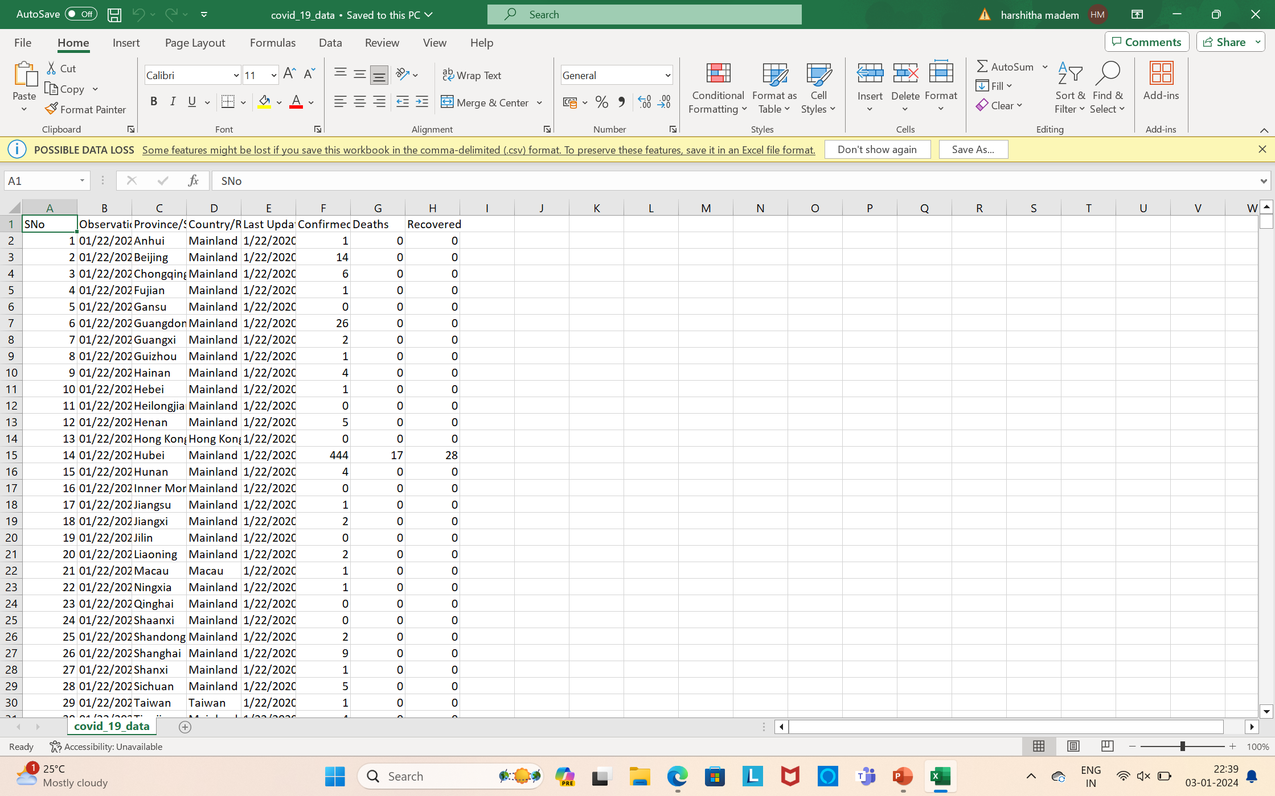
MODULE 1:Dataset Collection
COVID-19 datasets, employed in the initial step of modeling, are comprehensive collections of structured information capturing various aspects of the pandemic. These datasets encompass geographic details, temporal information, demographic statistics, testing data, and the number of confirmed cases, recoveries, and fatalities. Additional features may include details on public health interventions, hospitalizations, and vaccination progress. Leveraging historical data from the onset of the pandemic, these datasets enable machine learning models to adapt to evolving virus dynamics and discern patterns. The inclusion of diverse features and data from various regions enhances the models' ability to generalize and predict the trajectory of the virus, contributing to informed decision-making in managing the ongoing global health crisis.

Slide 12
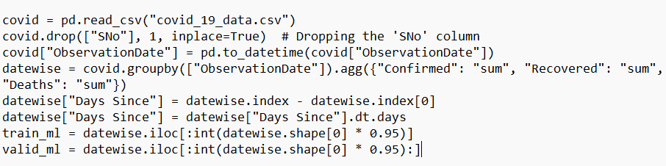

MODULE 2:Data Preprocessing
The dataset is read from the "covid_19_data.csv" file, and the "SNo" column is dropped as it likely represents a serial number and doesn't contribute to the analysis.
The "ObservationDate" column is converted to datetime format for date-related operations.
The "Days Since" column is created to represent the number of days since the earliest observation date.
The dataset is split into training set (train_ml) and validation set (valid_ml) for machine learning modeling.

Slide 13
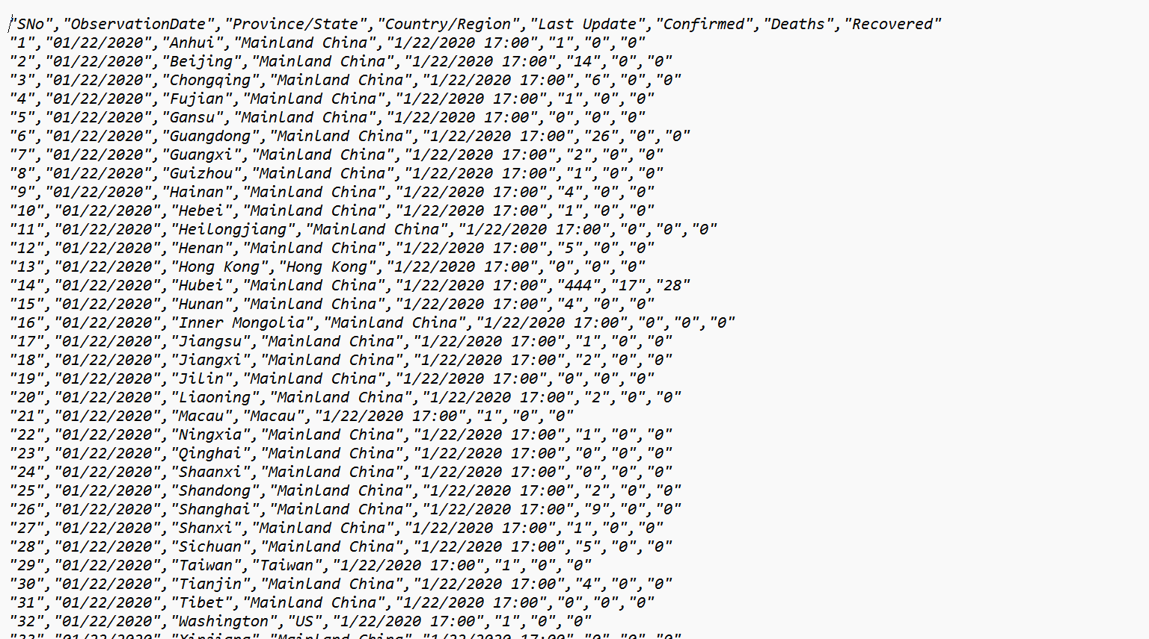
MODULE 3:Training Data
train_ml is created by selecting the first 95% of rows from the datewise DataFrame. This subset is used as the training data for machine learning models.

Slide 14
Module 3- SVM Algorithm
Support Vector Machine (SVM) is a supervised learning algorithm widely used for classification and regression tasks. Its primary objective is to find the optimal hyperplane in a high-dimensional space that effectively separates different classes in the data. This hyperplane is positioned to maximize the margin, which is the distance between the hyperplane and the nearest data points of each class, known as support vectors. SVM is versatile and can handle both linear and non-linear relationships between features through the use of kernel functions, such as polynomial or radial basis function kernels.
In the context of COVID-19 prediction, SVM proves to be a valuable tool due to its ability to handle complex and non-linear relationships within the data. COVID-19 datasets often contain diverse factors like geographic location, demographic information, and intervention measures, contributing to intricate patterns. SVM excels in identifying support vectors that are crucial in defining decision boundaries, adapting to the non-linear dynamics of the pandemic. By discerning patterns and relationships, SVM can contribute to accurate predictions of COVID-19 trends, aiding in understanding and anticipating the impact of various factors on the spread and severity of the virus. Its adaptability and robust performance make SVM a suitable choice for the nuanced and multifaceted nature of COVID-19 prediction tasks.

Slide 15
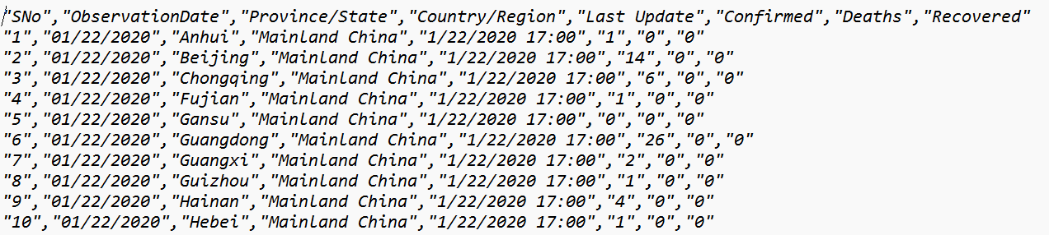
MODULE 4:Testing Data
This would select the remaining 5% of rows, making it the validation (or testing) data for evaluating the model's performance.

Slide 16
IMPLEMENTATION
Architecture Diagram
Data –Flow Diagram
Use Case Diagram
Class Diagram
Activity Diagram
Sequence Diagram
Collaboration Diagram(If applicable)
E-R Diagram
It’s a sample only and may vary according to the project

Slide 17
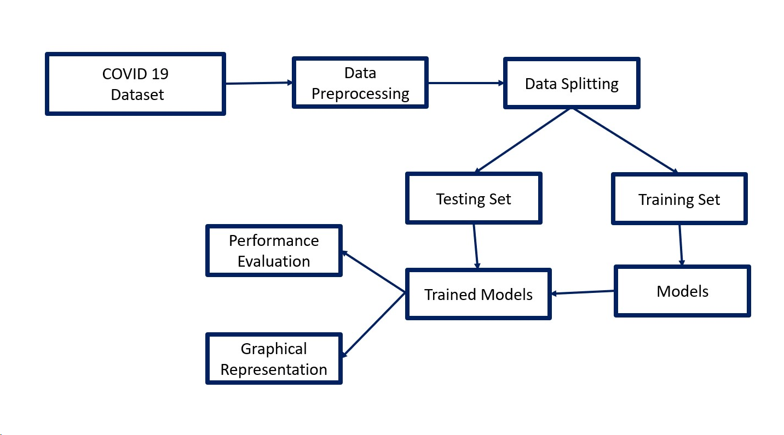
Architecture Diagram
The architecture begins with the collection of COVID-19 data, followed by the creation of a structured dataset that undergoes preprocessing steps such as cleaning, normalization, and handling of missing values. The dataset is then split into training and testing sets. The training set is employed to train machine learning models, resulting in a trained model capable of making predictions. Subsequently, the model's performance is evaluated using the testing set, employing metrics like accuracy and precision. Finally, the results are visually represented through graphical representations, providing insights into the effectiveness of the trained model in handling COVID-19 data.

Slide 18
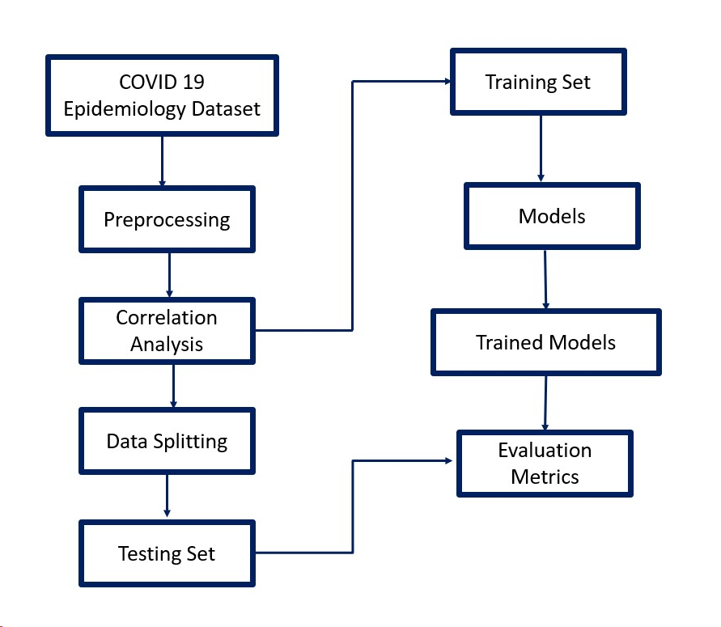
Data –Flow Diagram
The process of developing a model for COVID-19 prediction involves several key steps depicted in a Data-Flow Diagram. The journey begins with the collection of a COVID-19 dataset, followed by meticulous data preprocessing to ensure quality and relevance. Subsequently, correlation analysis is performed to identify relationships between variables. The dataset is then divided into training and testing sets for model development and evaluation. The training set is utilized to train predictive models, employing various algorithms. Once the models are trained, their performance is rigorously evaluated using the testing set, gauging their efficacy in forecasting COVID-19 outcomes.

Slide 19
Use Case Diagram
Preprocess data
Split Data
COVID-19 Analysis system
Train Model
Eva
Evaluate Model
extends
Request Data Analysis
User
View Model Performance
The system's use case diagram showcases users initiating actions like requesting data analysis and viewing model performance, while the "COVID-19 Analysis System" actor manages tasks such as data preprocessing, splitting, model training, and evaluation. This representation succinctly captures the collaboration between users and the system, offering a comprehensive insight into key processes in COVID-19 data analysis.

Slide 20
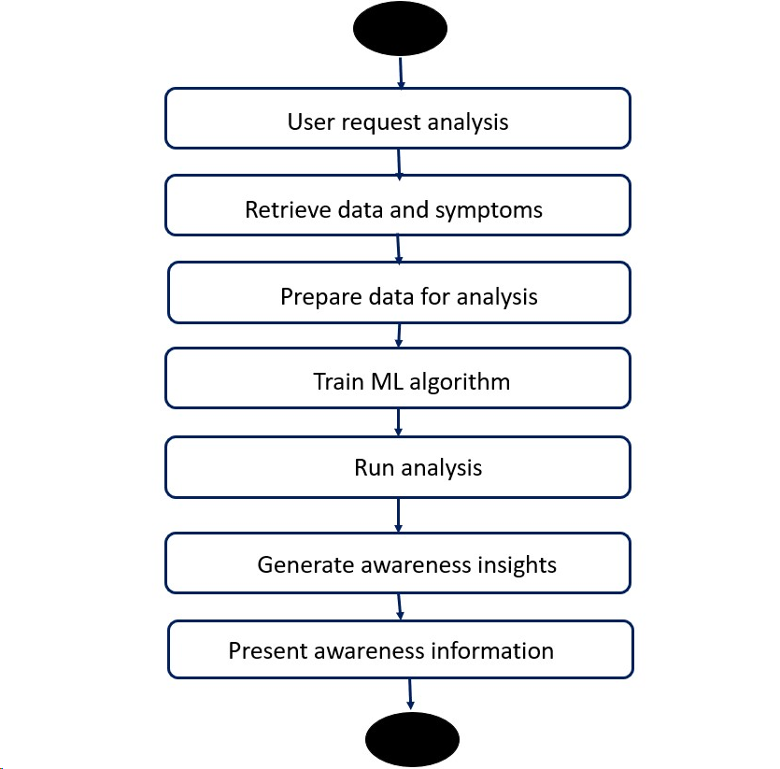
Activity Diagram
,
In response to a user's request for COVID-19 awareness analysis, the system sequentially retrieves relevant data and symptoms information. After preparing the data, a machine learning algorithm is trained, paving the way for a comprehensive analysis.

Slide 21
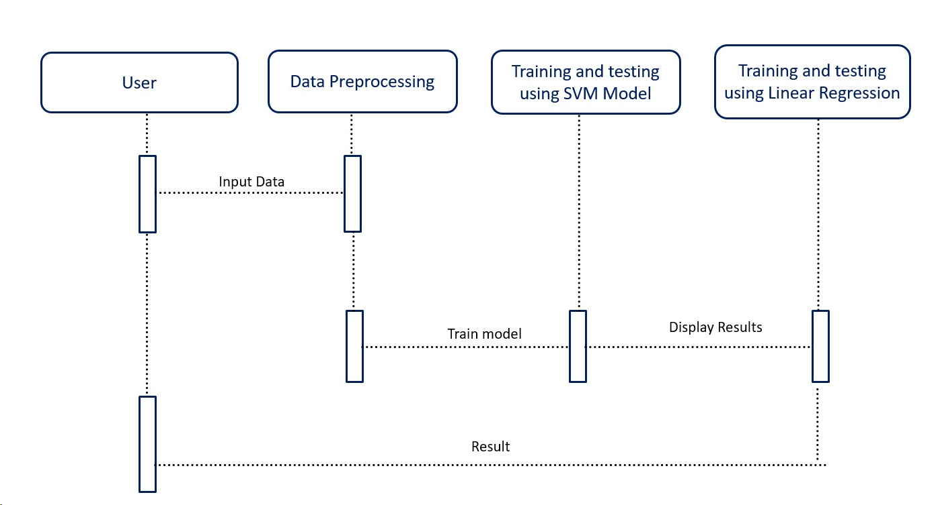
Sequence Diagram
,
The sequence diagram outlines the key steps in a covid 19 prediction.The process involves updating COVID-19 test results for shippers through the "UpdateCOVIDResult" function, ensuring accurate data. Successful COVID-19 result updates are confirmed, leading to the final step of confirming a shipment request using "ConfirmShipment()". The diagram succinctly captures the sequential interactions within the system, emphasizing stakeholder validation, health data management, and the confirmation of shipment requests.

Slide 22
E-R Diagram
Symptom_Name
Username
Symptom_ID
Description
Email
Preferences
U
User
Preferences
Symptoms
Requests
Based on
Data source
Based on
Insights
Source_ID
Description
Insight_ID
Timestamp
Source_Name
Analysis_Result
The ER diagram represents the relationships between users, symptoms, data sources, and insights. It allows for a detailed understanding of how users' preferences and requests are linked to the symptoms, data sources, and the generated awareness insights, providing a comprehensive visualization of the system's structure.

Slide 23
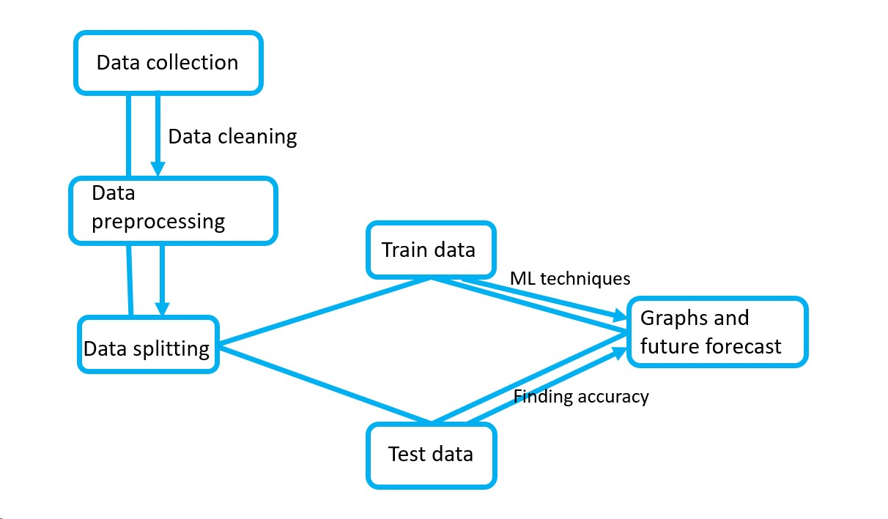
Collaboration Diagram(If applicable)
,
In analyzing COVID-19 survey data collaboratively, the aim is to work together to collect diverse datasets, utilize collaborative diagrams to visualize interactions, and jointly clean and preprocess information. Collaborative efforts extend to applying ML techniques for insightful analysis, while the team collaborates on data splitting for robust training and testing. Accuracy assessments involve collective analysis, ensuring a comprehensive evaluation of results.

Slide 24
TESTING
UNIT TESTING
INTEGRATION TESTING
FUNCTIONAL TESTING
WHITE BOX TESTING
BLACK BOX TESTING

Slide 25
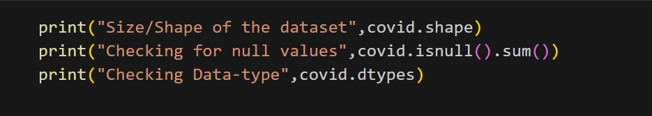
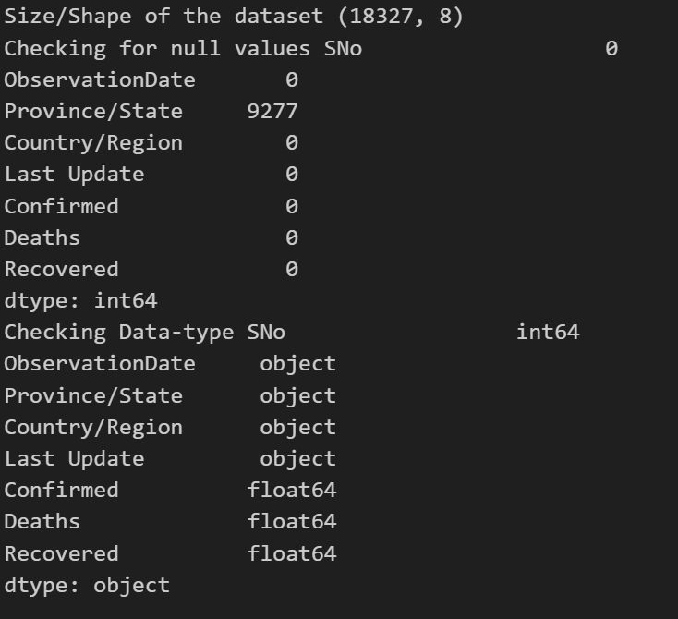
UNIT TESTING
The provided code, when executed, prints the size and shape of the 'covid' dataset, checks for any null values, and displays the data types of its columns, producing essential information about the dataset.
output:

Slide 26
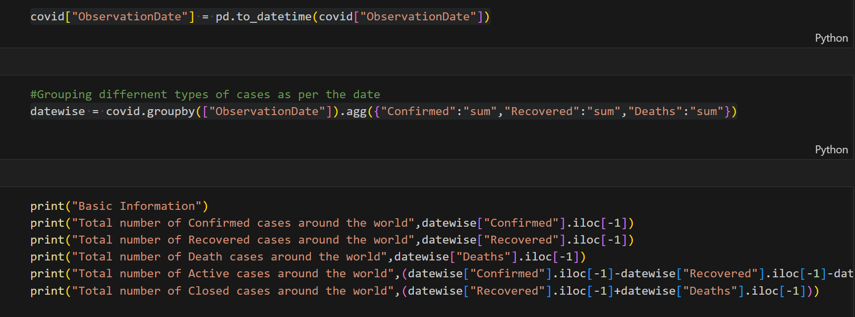
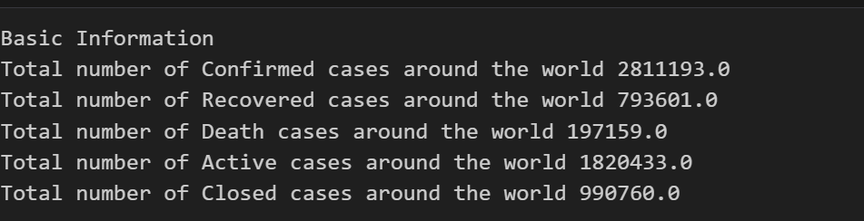
INTEGRATION TESTING
The 'ObservationDate' variable is dependent on the 'datewise' dataframe in this code. It is used as a crucial factor for grouping and aggregating COVID-19 data, and subsequent calculations such as the total number of confirmed, recovered, and death cases are performed based on the dates present in the 'ObservationDate' column of the 'datewise' dataframe.
Output:

Slide 27
SYSTEM TESTING
System testing for COVID-19 prediction involves a thorough evaluation of the integrated model, from the training phase to data manipulation, preprocessing, and feature extraction. The system is scrutinized for its ability to learn and adapt to COVID-19 datasets, ensuring accurate predictions. Rigorous testing of regression analysis models is conducted to assess the system's reliability in predicting the rate of disease spread for the next 7 days across various scenarios. Challenges, such as cybersecurity risks and data privacy concerns, are addressed, and the system's adaptability to diverse datasets and regions is validated. The advantages, including systematic training and preprocessing steps, are evaluated to confirm their positive contribution to the overall system performance. System testing is crucial to validate the reliability and effectiveness of the COVID-19 predictive model before its deployment for proactive decision-making in managing the global health crisis.
FUNCTIONAL TESTING
Functional testing in the context of COVID-19 prediction involves assessing the individual components and functionalities of the predictive model to ensure they perform according to the specified requirements. The testing phase evaluates whether each function of the system operates as intended, starting from the training phase where the model learns and adapts to COVID-19 datasets. It scrutinizes the data manipulation, preprocessing, and feature extraction steps to confirm that the input data is appropriately formatted and relevant features are accurately extracted. Additionally, functional testing assesses the system's ability to handle diverse datasets, considering variations in regions and scenarios. During regression analysis, the functionality of predicting the rate of disease spread for the next 7 days is rigorously tested to validate its accuracy and reliability. The system's capacity to address challenges such as cybersecurity risks and data privacy concerns is also examined, ensuring that the functional aspects align with the goals of providing accurate and secure COVID-19 predictions. Functional testing is essential to guarantee the robustness and effectiveness of each component within the predictive model, contributing to its overall reliability in supporting proactive decision-making during the ongoing global health crisis.

Slide 28
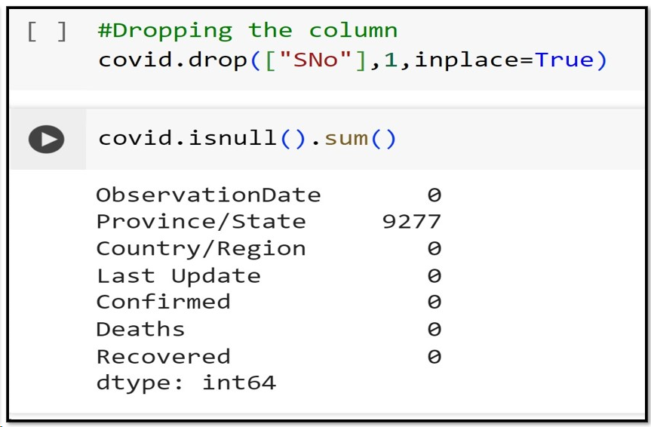
FUNCTIONAL TESTING
The Figure 5.6, includes loading the dataset, managing null values, removing the ”SNo” column, and converting ”ObservationDate” to datetime format, are part of functional testing. Functional testing ensures that these data processing operations within the code function correctly and adhere to the expected behavior, contributing to the overall functionality and integrity of the software system.

Slide 29
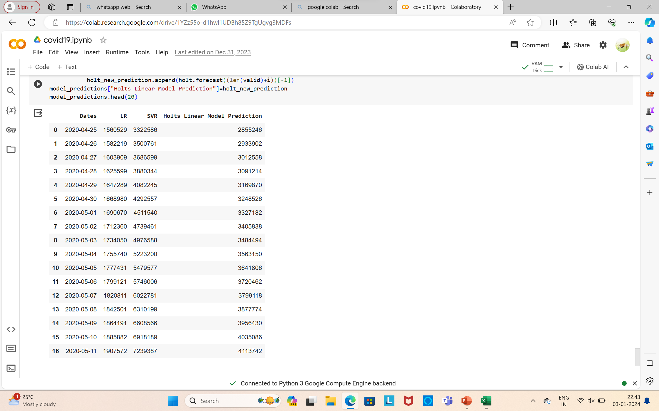
INPUT AND OUTPUT

Slide 30
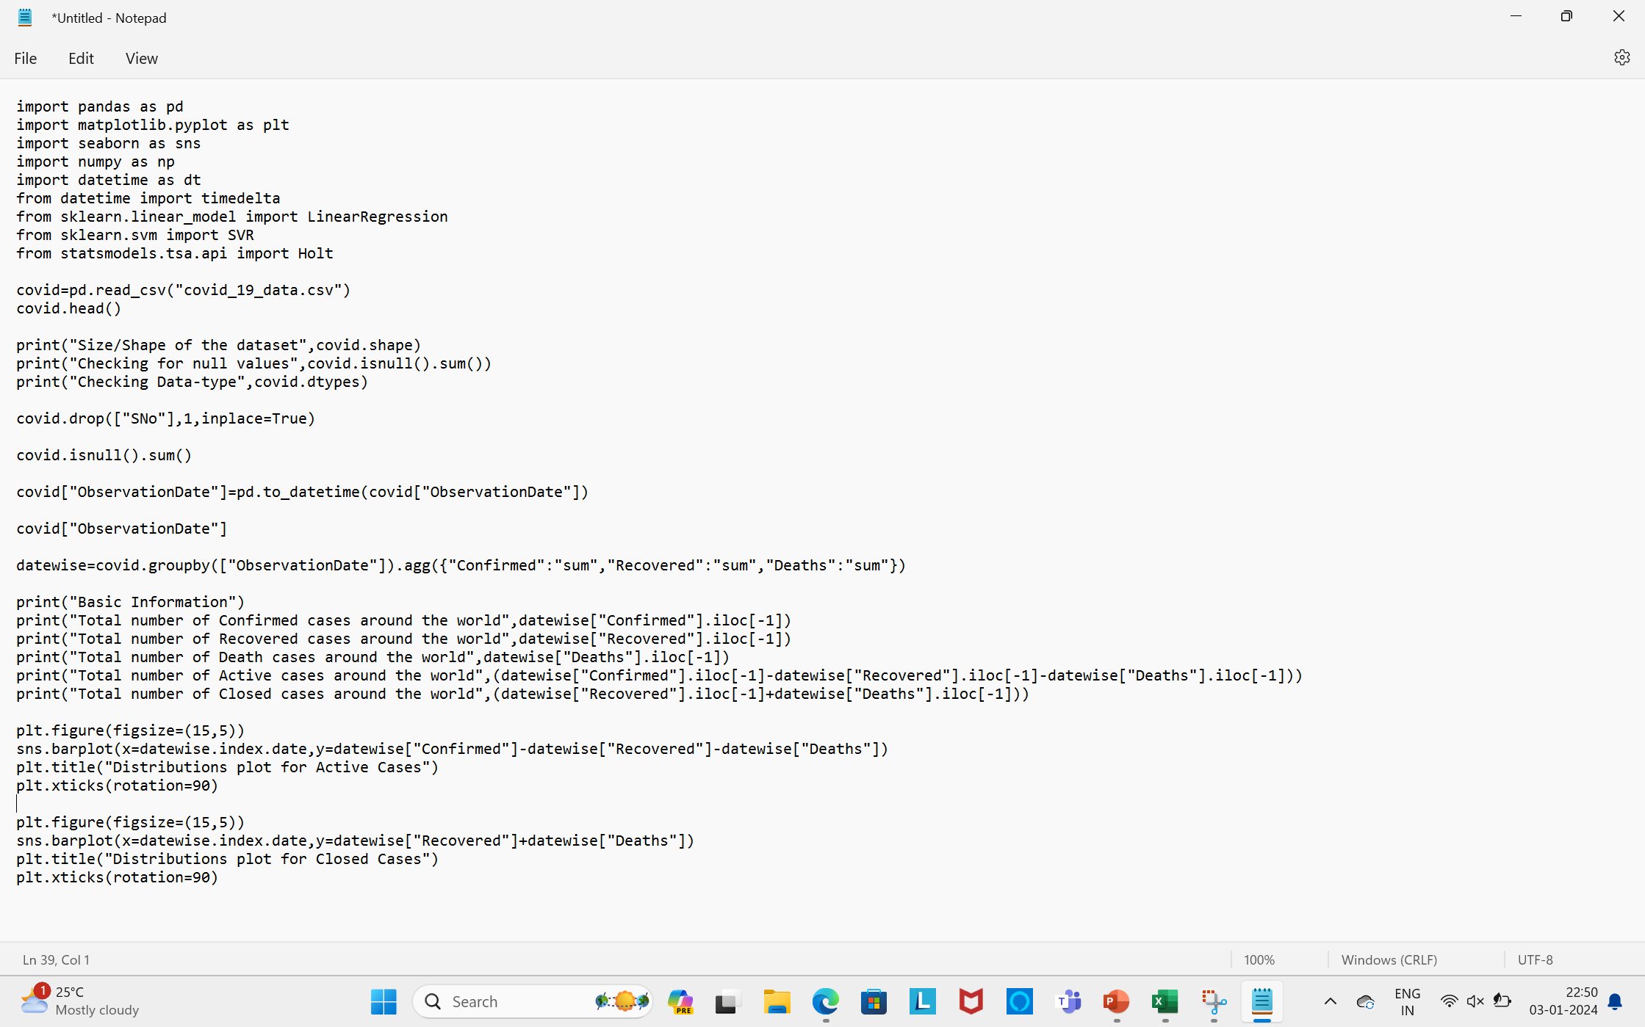
SOURCE CODE

Slide 31
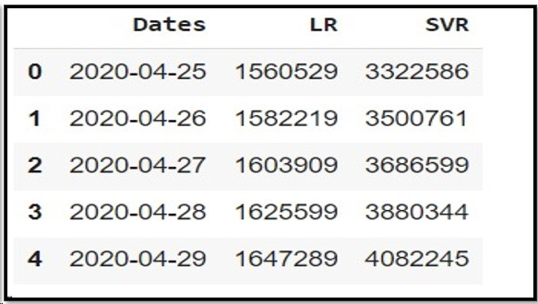
OUTPUT
The output design describes the prediction for future dates using LR and SVR models. For each date in the next 17 days, the code appends the date to a list and predicts the number of cases using the LR and SVR models.The resulting predictions, along with their corresponding dates, are organized into a Pandas DataFrame named model predictions. This output serves as a concise representation of the forecasted values from both LR and SVR models, allowing for a comparative analysis of their predictions for the specified future dates.

Slide 32
Objective: Analyze and summarize COVID-19 dataset using data frames to provide accurate information about the virus.
Dataset Utilization:
Employ data frames for effective analysis and summarization of the COVID-19 dataset.
ML Techniques Implementation:
Use machine learning techniques to predict and analyze COVID-19 data.
Time Series Forecasting:
Utilize time series forecasting to predict confirmed cases for the next ten days.
Performance Evaluation:
Aim for a 93.74 percent accuracy of prediction interval for the confirmed cases.
Practical Use:
Highlight the importance of accurate predictions for public health measures and decision-making during the ongoing pandemic.
Continuous Monitoring:
Emphasize the need for continuous monitoring and updating of the model as new data becomes available.
Communication of Results:
Clearly communicate the results of the analysis to the public for better awareness and understanding of the COVID-19 situation.
Accuracy Assurance:
Stress the importance of achieving a 93.74 percent accuracy level for confidence in the prediction intervals.
CONCLUSION

Slide 33
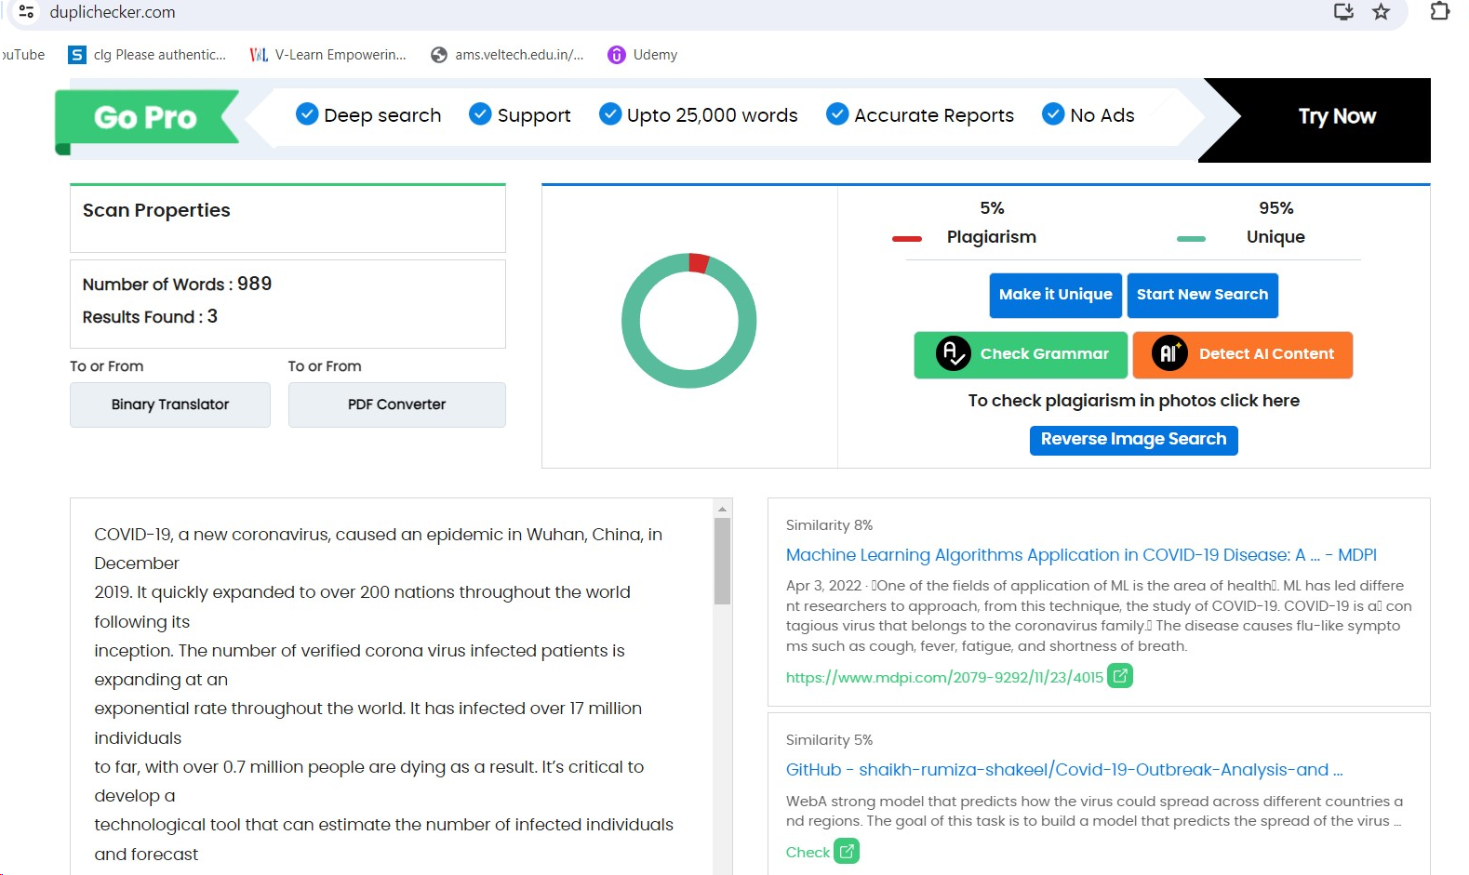
Plagiarism Report of PPT

Slide 34
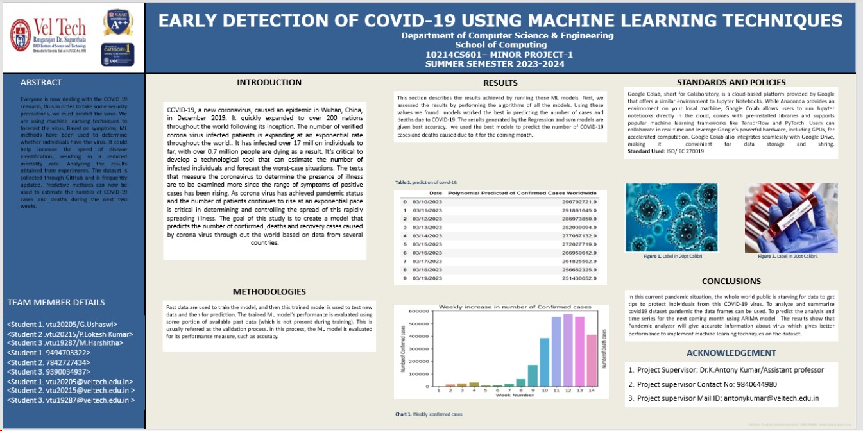
POSTER PRESENTATION

Slide 35
Web references/video links
https://www.ncbi.nlm.nih.gov/pmc/articles/PMC8137961/
https://www.sciencedirect.com/science/article/pii/S2666307423000037
https://youtu.be/rvBNwaOwZyA?si=dcc-9huBlIgvScMS
https://www.youtube.com/live/QuY0Wg-C89E?si=_AUGPGz4VxwdHuLW

Slide 36
REFERENCES
[1] S. Tiwari, P. Chanak and S. K. Singh, "A Review of the Machine Learning Algorithms for Covid-19 Case Analysis," in
IEEE Transactions on Artificial Intelligence, vol. 4, no. 1, pp. 44-59, Feb. 2023, doi: 10.1109/TAI.2022.3142241.
[2] F. Rustam et al., "COVID-19 Future Forecasting Using Supervised Machine Learning Models," in IEEE Access, vol. 8, pp. 101489-101499, 2020, doi: 10.1109/ACCESS.2020.2997311.
[3] A. K. Srivastava et al., "Machine Learning Approach for Forecast Analysis of Novel COVID-19 Scenarios in India," in IEEE Access, vol. 10, pp. 95106-95124, 2022, doi: 10.1109/ACCESS.2022.3204804.
[4] K. Narayan, H. Rathore and F. Znidi, "Using Epidemic Modeling, Machine Learning and Control Feedback Strategy for Policy Management of COVID-19," in IEEE Access, vol. 10, pp. 98244-98258, 2022, doi: 10.1109/ACCESS.2022.3206790.
[5] H. L. Gururaj, B. C. Soundarya, and V. Janhavi, "Machine Learning Algorithm for Covid-19 Prediction," in IEEE technology Policy and Ethics, vol. 7, no. 1, pp. 1-5, Jan. 2022, DOI: [10.1109/NTPE.2022.9778144](https://doi.org/10.1109/NTPE.2022.9778144).

Slide 37
THANK YOU

